Slide 1

Architectures and Systems for Mobile-Cloud Computing: A Workload-Driven Perspective
S2014-6613
Xin Zhang
Adviser: Mayur Naik
CS
Georgia Tech
Prashant Nair
Adviser: Moin Qureshi
ECE
Georgia Tech
Notes:
~30 seconds
Briefly introduce ourselves

Slide 2
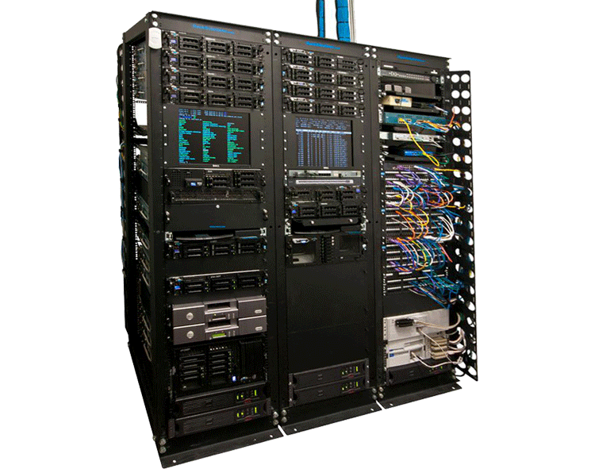

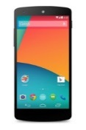
Motivation
Mobile devices have become the primary computing device
…
performance
2G
3G
4G
…
years
Notes:
~1min
Mobile devices are becoming the primary computing devices
The performance of mobile devices have improved dramatically in the past years but still there’s large gap between server performance and mobile performance.
It is unlikely that the performance of mobile devices will catch up servers because of stringent limits on the size, weight, and energy constraints.
The speed and coverage of mobile networks have improved rapidly in past years.
One way to bridge the gap between people’s increasing demands on mobile applications and limited power of mobile devices is to offload computation from mobile devices to the cloud.

Slide 3
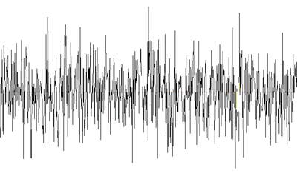



Hello Siri, What is Mobile Cloud Computing?
“Dialing 123-456-7890”
“Call John.”
Call John
Notes:
~1min
In fact, some mobile apps are already offloading computation to the cloud. On example is siri.
Describe the workflow of siri.

Slide 4
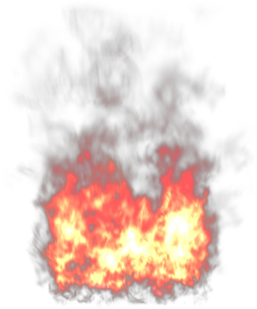

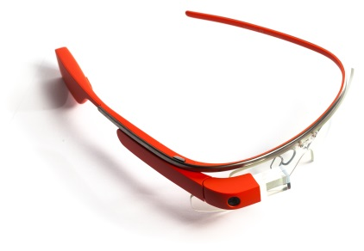
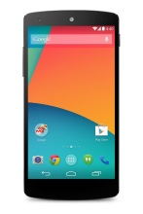
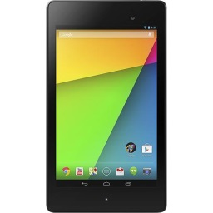

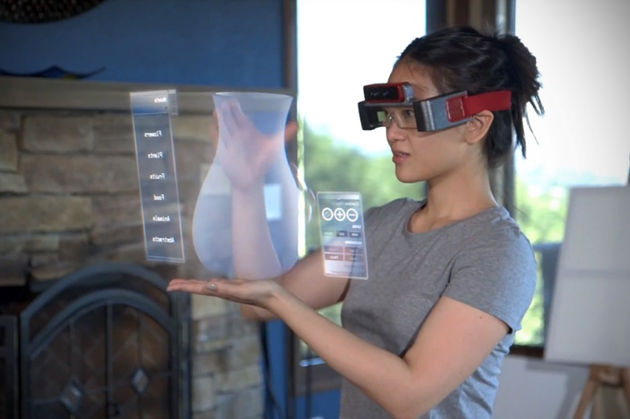
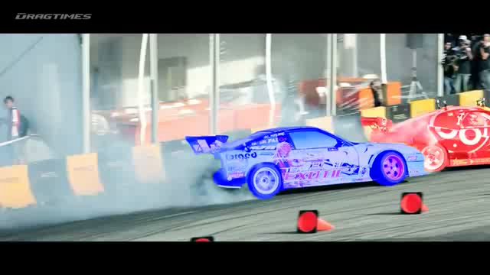

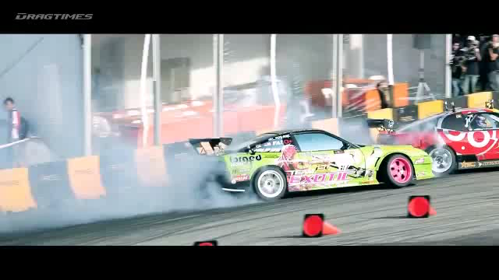
Mobile-Cloud: Enabling New Applications
Idea: Offload Computation to Cloud
Notes:
~1min
Mobile cloud computing will bring richer and more powerful apps.
Mobile devices have rich sensors. (phone, tablet and even wearable devices)
Using these sensors we can implement applications like augmented reality.
However mobile devices do not have the power to run them(show videos)
Mobile-cloud computing is the rescue(show another pair of videos)

Slide 5
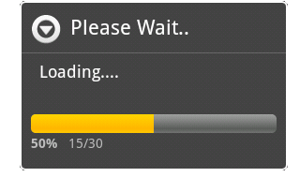



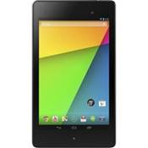



Key Challenges
1. Interleaved I/O and computation
2. Network latency
01010101011010100101
11110101110001
11000001011010101101
01010101010101
3. Diverse and dynamic execution environment
Notes:
~1min30s
Introduce the naïve offloading scheme (Siri)
It does not work in practice because:
1. Interleaved I/O and computation(talk about the progress bar example)
2. Network latency
3. Diverse and dynamic environment

Slide 6
Our Solution: Flexible Offloading Schemes
Challenge 1: Interleaved I/O and computation
Bi-directional offloading
11010001000101
01010
01010101010101
11000
Notes:
~45s
Illustrate bi-directional offloading.
The catch is to allow interrupting the cloud executing to access I/O on mobile.

Slide 7
Our Solution: Lower Bandwidth via Persistence
Challenge 2: Network latency
Persistent cloud
00011100010101
01010101010101
01010
∆
11010101000101
Notes:
~45s
Illustrate persistent cloud. The catch is to utilize locality and partition the program. As a result, part of the program data lives on the cloud, part lives on the mobile.
Change <instead of 10010101 from the mobile to cloud, send a symbol delta>

Slide 8





Our Solution: Analytical Models for Tradeoffs
Challenge 3: Diverse and dynamic execution environment
Network features
Hardware features
Analytical model
Runtime decision!
Software features
Notes:
~1min
Building analytical model:
Trace workload from mobile apps, and extract software features
Network features
Hardware features

Slide 9


Offloading System
Offloading schemes
How to offload
What to offload
Analytical model
Notes:
~50s
Round up.
The offloading schemes tell our system how to offload a certain part of computation. Analytical model tells which part to offload at runtime.
As a result, our system will be able to handle a large range of mobile apps, diverse hardware devices and different network nections

Slide 10
Roadmap
Mobile workload tracing
Trace mobile workloads of top 150 Google Play apps
Workload characterization
Identify features common and unique to mobile workloads
Analytical models of performance and energy usage
Produce tolerable error bounds compared to hardware measurement
Mobile-cloud computing system
Show speedup and energy savings
(Infrastructure implemented)
(~3 months)
(~3 months)
(~6 months)
Notes:
~1min

Slide 11
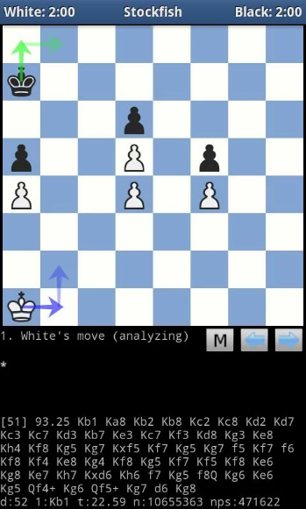
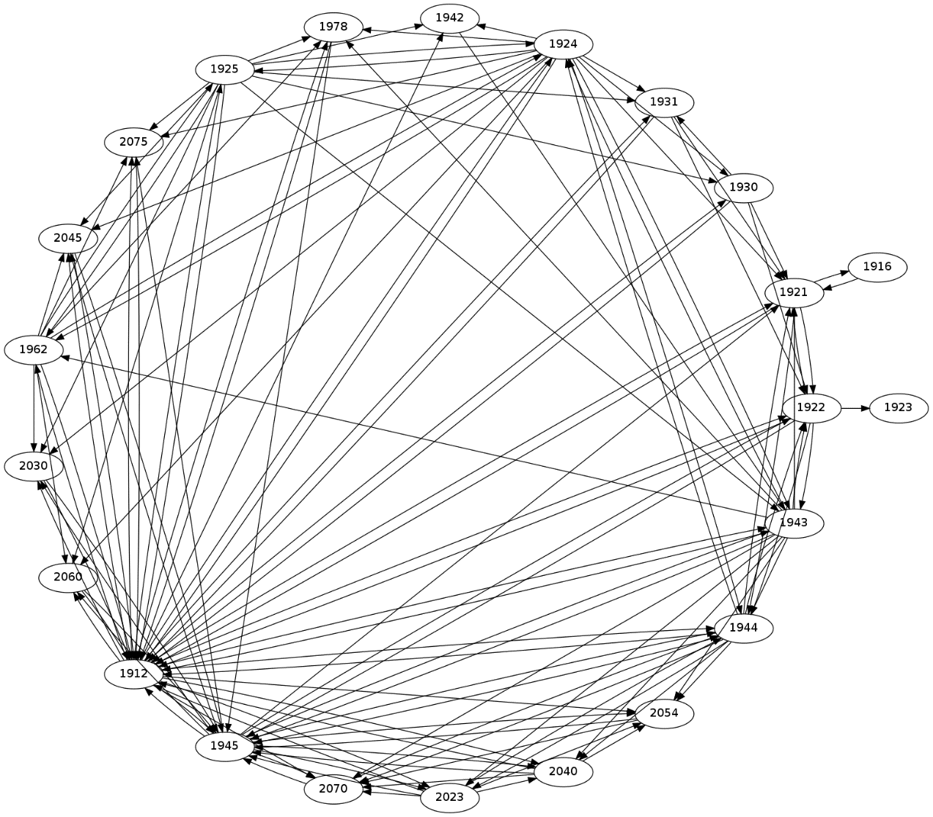
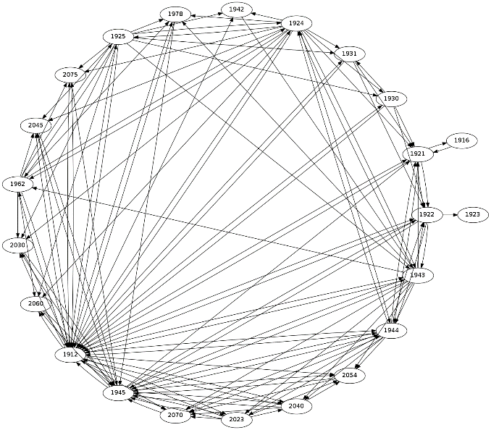

Result of Tracing “Chess” For 10 Rounds
24 threads
3 million function calls
17 million memory reads
13 million memory writes
UI
AI
Notes:
~1min
Show the statistics.(Mention that there’re many threads, but many don’t live long.) Explain thread dependency graph (read-write dependency).
Explain the computation I/O interleaving bar graph(well, actually it is offloadable vs. unoffloadable in fact)
Say this app has a relative simple algorithm in AI. Mobile cloud computing can enable more sophisticated algorithm.

Slide 12




Summary
Mobile devices have become the new “PC”
Big performance gap between mobile and desktop
Our Proposal:
Enable desktop-class performance for mobile apps by:
Offloading computation to the cloud
Using robust analytical modeling
Enable new applications and usage models
Notes:
~1min
Talk about motivation again
What we try to do
Broader impact on programming and hardware, give vision
<adjust the smiliy with border>

